Slide 1
UNIT-IV: WIND ENERGY SYSTEMS:
Generation schemes with variable speed turbines: classification of schemes – operating area –Induction Generators-Doubly fed Induction generators-Equivalent circuits-Reactive power and harmonics-Double output system with VSI-Variable voltage, variable frequency generation-circuit model and steady state operation and characteristics- effect of wind generator on the network. Wind speed measurements-Wind speed statistics-site and turbine selection.

Slide 2
Generation schemes with variable speed turbines:
classification of schemes
Broadly, four different systems are used for generation of electricity from wind power.
Constant-speed, constant-frequency
Near-constant-speed, constant-frequency
Variable-speed, variable-frequency
Variable-speed, constant-frequency

Slide 3
4.1.1.1 Constant-speed, constant-frequency
The generation scheme in this category is based on fixed-speed technology. The horizontal-axis wind turbine, whose speed can
be controlled by using a pitch-control mechanism, operates at a
constant speed and drives, through a gear box, a synchronous or an induction generator that is connected to the power network.
A constant-speed wind turbine can achieve maximum
efficiency at the speed that gives the tip speed ratio the value corresponding to the maximum power coefficient Cp Opt. Its main weakness lies in its poor energy capture from the available wind power at other wind speeds. Moreover, a pitch-control mechanism adds considerably to the cost of the machines and stresses the operating mechanism and the machines.

Slide 4
Near-constant-speed, constant-frequency
In this scheme, induction generators feed power to the utility
network at variable slip. Here also the generators are driven by horizontal-axis wind turbines but with a less stringent pitch angle controller, which can maintain small values of slip.
Variable-speed, variable-frequency
This scheme employs capacitor self-excited three-phase or single phase induction generators for small-scale power generation as a
source of isolated supply to feed frequency-insensitive loads.

Slide 5
4.1.1.4 Variable-speed, constant-frequency
Wind turbines are basically variable-speed prime movers. This category implies a wide and continuous range of
variable-speed operation of the turbine and the processing
of power ultimately at the synchronous frequency of the utility system. Variable-speed operation of wind turbines offers several benefits. So there is a general trend now
towards generation schemes employing variable- speed turbines. There are many reasons for such a choice, which may be briefly summarized as follows.

Slide 6
Benefits of Variable-speed, constant-frequency
Continuous operation of wind turbines at the optimum tip speed to wind speed ratio by changing
the rotor speed with the wind velocity. This increases energy capture even under low wind conditions.
Reduction in noise emission from wind turbines at
low wind speeds.
Reduction in the size and weight of the gear box, or its total elimination, together with the associated noise
The possibility of power smoothing due to the inertial energy storage in the turbine rotor

Slide 7
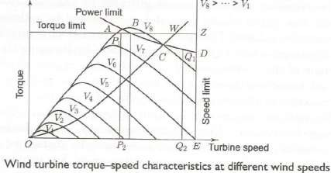
4.1.2 Operating Area
AB, BD, and DE, respectively, define the limits of shaft torque, power, and speed. Within the area OABDE a number of control strategies can be adopted. The operating point in the torque-speed plane for variable-speed operation at maximum C, follows the square-law curve OC. At C, the power limit is reached, beyond which the turbine operates along CD, maintaining a constant power limit at reduced torque until the speed limit Q1Q2 is reached. Constant-speed operation along P P2 and Q1Q2 are limited by the maximum torque and maximum power, respectively. If the torque and the speed constitute the only turbine operation limits, OAZE would be the safe operating area of the turbine. This will allow an improvement in the energy capture up to W.

Slide 8
4.2 Induction Generators
An induction machine in the generating mode operates fundamental tally in the same manner as in the motoring
mode except for the reversal of power flow. Consequently,
the equivalent circuit and the associated performance equations, derived earlier using motoring conventions, are valid for all values of slip. With the stator winding
remaining connected to the utility grid, if the rotor is driven by a prime mover above the synchronous speed in the direction of the air-gap field, the mechanical power of the prime mover is converted into electrical power.

Slide 9
4.2.1 Cage Rotor Induction Generator Fixed-speed system
The system in the general sense implies the use of the squirrel cage induction generator, which provides the power output only through the stator winding. Figure 2 illustrates the configuration. It requires a grid-connected squirrel cage induction generator coupled to a turbine through a gear box. The gear steps up the rotor speed to a value matching a 50- or 60 Hz utility network. The generator always draws reactive power from the network. Capacitors are used to compensate this lagging VAR. These capacitors may cause the induction machine to self-excite, leading to over voltages at the time of the disconnection of the wind turbine from the electrical system if proper protective measures are not taken. Because of its coupling to the grid, the speed varies over a very small range above synchronous speed, usually around 1%. As the speed variation is small, the system is commonly known as a fixed-speed system. For such a system, the tip speed ratio varies over a wide range, making the rotor efficiency suffer at wind speeds other than the rated wind speed. The gear box ratio is

Slide 10
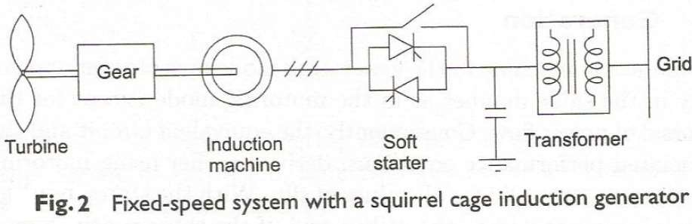
selected for optimal C, for the most frequent wind speed. In a well-designed system, fixed-speed operation can extract about 80% of the energy available from a fully variable speed system over a year. Fixed-speed wind turbines employing either blade pitch regulation or stall regulation to limit the power at high wind speeds are used. It is necessary to do so because if the input mechanical power is more than the power corresponding to the pull-out torque, the system becomes unstable.

Slide 11
Semi-variable-speed operation
The advantages of a grid-connected, fixed-speed squirrel cage generator are its lower capital cost, simple system configuration, and robust mechanical design. As the rotor speed is nearly constant, fluctuations in wind speed result in torque (power) excursions, which may lead to unwanted grid voltage fluctuation and strains on the turbine components. Wind gusts in particular lead to large torque variations.
Limited variable-speed operation in this single-output system can bring down the pulsations in grid power (voltage) and me mechanical stress.

Slide 12
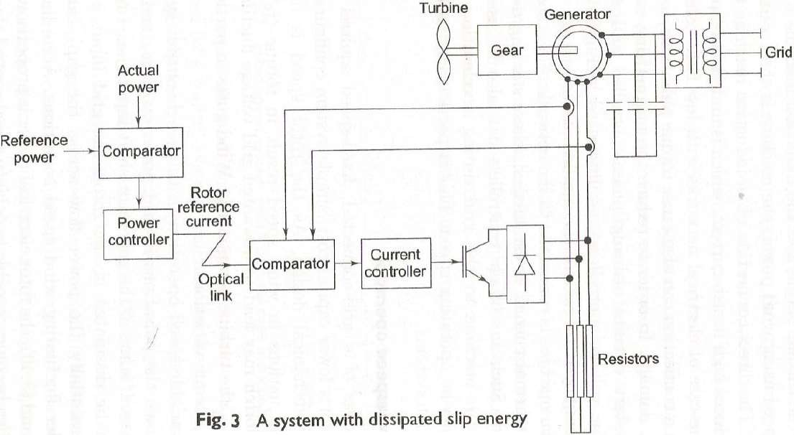

Slide 13
Figure presents a configuration which includes a gear box, an induction motor with a three-phase stator winding, and a wound rotor with an electronically variable rotor resistance. The converter and the resistance rotate with the rotor. Control signals are sent to the rotating electronic parts by opto-electronic means. The rotor current reference comes from the comparison between the actual power and the reference power. The average resistance is varied between zero and the full value by continuously adjusting the duty cycle of the transistor switch. When the wind speed goes above the nominal value, the rotor current is held constant at a value corresponding to the rated power, by decreasing the duty cycle of the transistor switch. This will cause the generator speed to change, at the same time maintaining constant stator power. This configuration allows limited speed variation. The system shown in this figure is being marketed by Vestas of Denmark under the trade name OptiSlip with a maximum variation of 10% over nominal speed.

Slide 14
4.2.2 Doubly fed Induction generators
With a slip-ring induction machine, power can be fed into the supply system over a wide speed range by appropriately controlling the rotor power from a variable-frequency source. The provision for bidirectional flow of power through the rotor circuit can be achieved by the use of a slip-ring induction motor with an ac/dc/ac converter connected between the slip-ring terminals and the utility grid. The basic configuration of the system is shown in Fig. 4.The system is known as a double-output induction generator (DOIG) because power can be tapped both from the stator and from the rotor. Figure 5 presents the main components of the solid-state system for the controlled flow of slip power at variable speed through current converters. The intermediate smoothing reactor is needed to maintain current continuity and reduce ripples in the link circuit. For the transfer of electrical power from the rotor circuit to the supply, converters I and II are operated, respectively, in the rectification and inversion modes. On the other hand, for power flow in the reverse direction, converter II acts as a rectifier and converter I as an inverter. The step-down transformer between converter II and the supply extends the control range of the firing delay angle a2 of converter II.

Slide 15
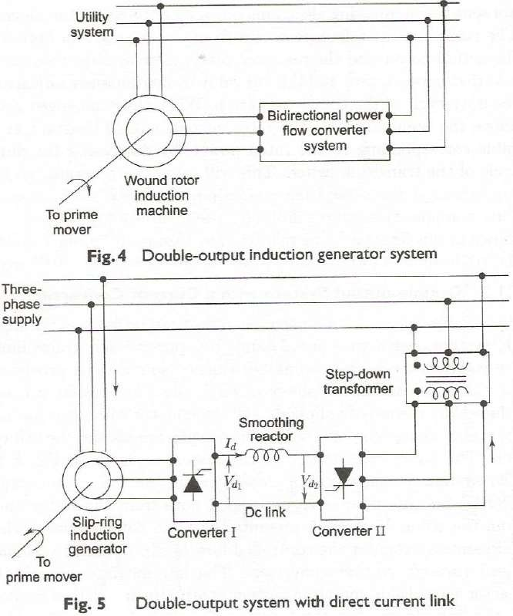

Slide 16
The firing delay angle a of converter I on the rotor side controls the phase difference between the injected rotor phase voltage and the rotor current, while the delay angle az of converter II on the line side dictates the injected voltage into the rotor circuit.
Line-commutated converters cannot generate leading VAR, and so, for maximization of the power output, a should be set at 0° (rectification mode) in the super synchronous region above the rated speed n, (see Fig. 3.5) to draw power out of the rotor, and at 180° (inversion mode) in the sub synchronous region to inject power at the slip frequency into the rotor circuit. Power flow characteristics can be studied using ac as well as dc equivalent circuits. A reasonable estimate for the required variation in a2 as a function of slip can be obtained by considering the de voltage balance between the two sides of the smoothing reactor in the anti parallel bridge network.

Slide 17
4.3 Equivalent circuits To derive the equivalent circuits and analyse this system, we make the following assumptions.
The magnetizing current and iron loss are neglected.
The inverter-side transformer is assumed to be ideal.
The commutation of the switching devices instantaneous and the device losses are neglected.
The harmonic effects are ignored.
is assumed to be

Slide 18




4.3.1 The ac equivalent circuit the average voltage output of converter I at a slip s is given by
For converter II, the average voltage output is given by
For dc voltage balance, neglecting the resistance drop in the dc-link smoothing inductor
Vd1 + Vd2 = 0
This yields
Under the assumption of negligible stator impedance drops, V2’ Equals V1 and Eqn (5.4) becomes

Slide 19


In fact, the presence of the dc-link circuit resistance demands
Neglecting the losses in the semiconductor switches, the slip power, i.e., the rotor electrical power, is partly dissipated in the dc-link and rotor resistances, and the rest is fed back to the supply system through converter II. With reference to Fig. 5.5, the power input to converter II from the dc-link side (inverter operation) is
P2 = -Vd2.Id (5.7)
Using Eqn (5.2) in Eqn (5.7), we get
For 120° conduction of each device in the converters, the fundamental rms component I2 of the ac-side current of the converters (rotor or transformer secondary) and the dc-link current are related by

Slide 20

From Eqns (5.8) and (5.9), the power fed back to the supply by the rotor is obtained as
Referring the current I, to the stator side, we get
where ϕ2 is the supplementary of the delay angle α2 of converter II (i.e., ϕ2 = π- α2).
The rms value of the quasi-square wave rotor current is
The total secondary circuit copper loss

Slide 21
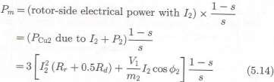

The rotor rms current consists of the fundamental rms component and the higher harmonic rms components. Assuming that the torque is produced by the fundamental component of the rotor current, mechanical power can be expressed as
The air-gap power is
Substituting the expressions for P2, PCw2, and Pm from Equations (5.11), (5.13), and (5.14), using Equations (5.9) and (5.12), and referring all the quantities to the stator side, we get
Now, the stator input power is given by

Slide 22
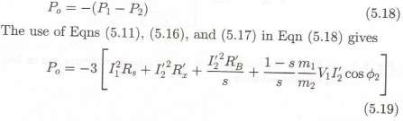
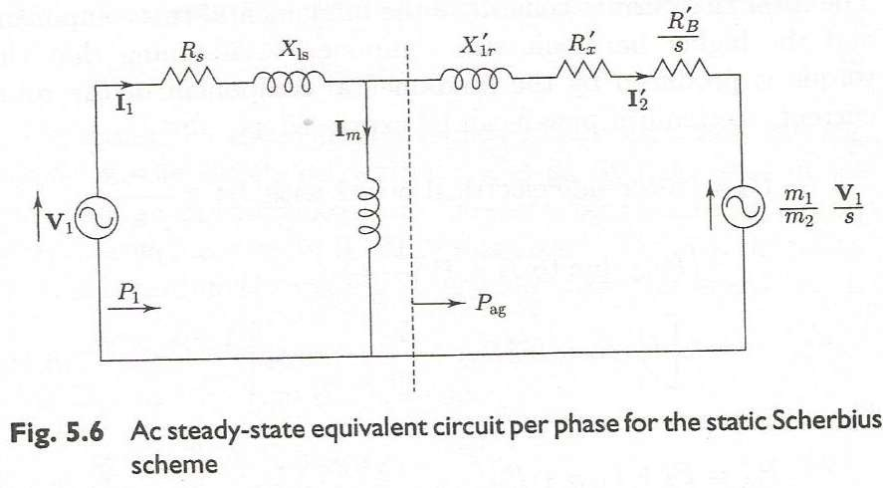
With reference to Fig. 5.5 and following the motoring convention, the net electrical power output for the generating operation,

Slide 23
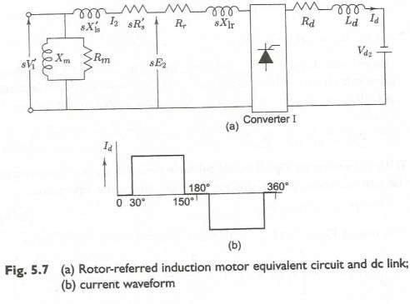
4.3.2 The dc equivalent circuit In Fig. 5.7, the ac side (up to the rotor-side converter) represents the per-phase equivalent circuit of the induction machine referred to the rotor. The dc side of the equivalent circuit (to the right of the rotor-side converter) consists of the series resistance of the smoothing reactor and a voltage source representing the line-side converter.

Slide 24

It is convenient to refer the complete equivalent circuit to the de side. First the ac-side resistances sRs’, and Rr, are converted to their dc equivalents. To find out the dc equivalent resistance, recall that the input current of a phase-controlled converter has a quasi-square waveform as shown in Fig. 5.7(b). In this figure, the dc-side current is assumed to be ripple-free. The commutation overlap effect is also neglected. The rms value of the ac line current in terms of the dc current) is given by
Now a resistance R connected to the dc side of the phase controlled converter I will be called the dc equivalent of the ac-side resistance if the power dissipated in Rde equals the total power dissipated in all three phases. The ohmic power dissipated in all the three phases of the induction motor is

Slide 25

Therefore, the equivalent de resistance of the induction motor when viewed from the dc- link side of converter I is
Once the resistance portion of the ac side equivalent circuit is transferred to the dc side, the rest of the ac circuit along with the rotor-side converter (I) can be represented by a de voltage source Vd, in series with an equivalent internal resistance Rd. This takes into account the reduction in the mean output voltage of converter I caused by the induction motor reactance. The values of Va and Rd, in terms of the ac-side circuit parameters are given by

Slide 26
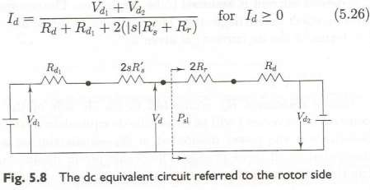
Being an inductive phenomenon, Rd1 does not represent a power loss component. Figure
5.8 shows the complete equivalent circuit referred to the de side. Note that the entire slip power, i.e., the rotor-side electrical power, is supplied to the right of the dotted line. From
the figure,
The condition Id ≥ 0 is required because the rotor-side and the line-side converter allow only unidirectional current. Substituting the expressions for Vd1, Vd2 and Rd1, in Eqn (5.26) and arranging the terms, we get

Slide 27
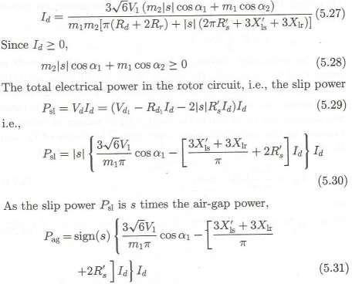

Slide 28
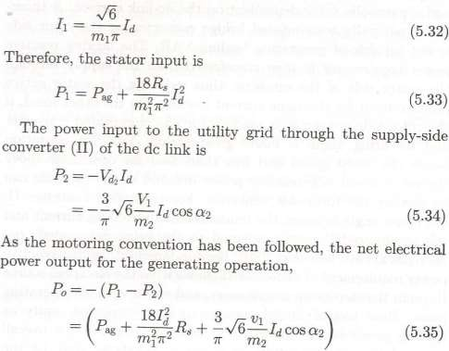
The approximate rms value of the fundamental component of the stator current for level dc-link current Id is

Slide 29

4.4 Reactive power and harmonics
The grid-connected induction generator draws its excitation from the power line to set up its rotating magnetic field for regeneration and thus always
demands lagging reactive power. Such reactive power demand may adversely affect the network voltage level particularly in weak public utility networks-and
increase system losses. For large wind turbines driving induction generators,
the voltage fluctuation and the flickering arising from power output variation may exceed the statutory limits of the utility system.
By applying the definition of reactive power Q = V1.I1.sinϕ1, to the T-circuit model of an induction motor [shown in Fig. 3.3(a)] the reactive power in one phase of the motor under the approximation I1 ≈ I2’ becomes

Slide 30
The reactive power consumed by the electrical machine thus comprises a constant value, which is the magnetizing volt-ampere, and a parabolic value dependent on the dc-link current. A three phase naturally commutated bridge converter on the rotor side is not capable of generating leading VAR. The lagging reactive power requirement is then transferred from the supply through the stator side of the machine, thus reducing the stator active power output for the same current loading. On the other hand, if the rotor- side converter is made a forced-commutated converter and its firing angle is made greater than 180° for operation below the rated speed and less than zero for operation above the rated speed, the reactive power demand of the machine can be met by the rotor-side converter. For controlled converter II, the phase angle between the fundamental alternating current and the ac sinusoidal current is equal to the firing delay angle α2.
As α2 is always less than 180°, the fundamental lagging reactive power requirement of converter II comes from the electrical source through the step-down transformer, and varies with the operating point. Here too, if forced commutation is employed, unity or leading power-factor operation in order to improve the overall power factor of the system is possible. Whatever may be the firing strategy, the current-fed dc-link converter system
requires an expensive choke and an extra commutation circuit for operation at synchronous speed (if it lies within the operating speed range).

Slide 31
4.5 Double output system with VSI-Variable voltage, variable frequency generation Following the motoring convention, if the slip is negative, the motor input current will lag behind the supply voltage by an angle greater than π/2, as shown in Fig. 5.14, implying the induction machine to be a source of power.
It is evident that the inverted motor current, i.e., the current flowing out of the machine, leads the motor terminal voltage.
The machine, therefore, acts as a source of active power feeding a parallel combination of a capacitor and a resistor as shown in Fig. 5.14(b). If the reactive power oscillation between the capacitor and the machine's effective inductance, similar to a parallel resonant circuit, can be maintained, a voltage will be sustained across the
machine terminals. Initiation of the voltage build-up and its sustenance depend on several parameters, such as the load resistance, the capacitance, the speed, and the residual flux this is how a self-excited induction generator is obtained.

Slide 32
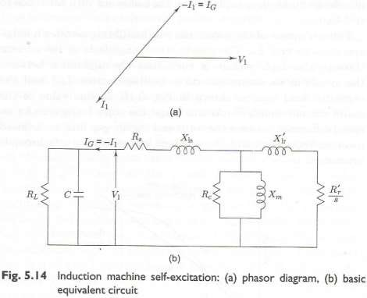

Slide 33
4.5.1 Circuit Model
In contrast to the source-connected generator, the capacitor self excited induction generator presents a unique aspect-the main flux saturation assumes fundamental importance in establishing the equilibrium, that is, in determining the voltage level and the output frequency of the generator, for a given load, speed, and excitation capacitance. The capacitor is required to provide the reactive power, and no external constraints (frequency and/or flux) are imposed on the system. An uncontrolled self-excited induction generator shows considerable variation in its terminal voltage, degree of saturation, and output frequency under varying load conditions. For a systematic study of the behaviour of such a stand-alone induction generator with a variable-frequency output, it is convenient to base the analysis on a circuit model whose parameters are defined in terms of a base frequency.
Figure 5.17 shows the per-phase, steady-state, stator-referred equivalent circuit of a
self-excited induction generator connected to a resistive-inductive load. A capacitor of capacitance Co is connected to provide the excitation VAR.

Slide 34
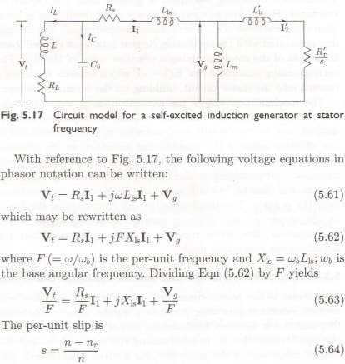
where nr is the synchronous speed corresponding to the generated terminal frequency. The slip given in Eqn (5.64) may be expressed as

Slide 35
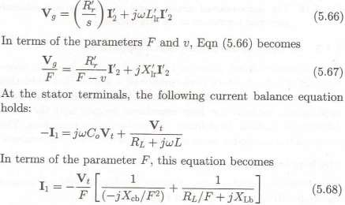
where v is the per-unit speed (nr/nb) defined with respect to the synchronous speed corresponding to the base frequency fb and F is as defined earlier.
The voltage equation for the rotor circuit shown in Fig. 5.17 is
where Xcb (= 1/wbCo) and XLb (=wbL) are, respectively, the reactance’s of the excitation capacitor and the inductor at the base frequency.
Equations (5.63), (5.67), and (5.68) redefine the parameters and the node voltages of the equivalent circuit shown in Fig. 5.17, as indicated in Fig. 5.18.

Slide 36
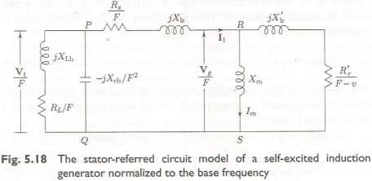
This stator-referred equivalent circuit, mapped in terms of the base frequency, is commonly used for predicting the performance of a self-excited induction generator.
In general, the speed and the load are the given parameters. The frequency, the excitation capacitance, and the magnetizing reactance constitute the set of unknown variables even when a desired terminal voltage is required to be maintained.

Slide 37
4.5.2 Analysis of the Steady-state Operation
4.5.2.1 The loop impedance method
Since there is no emf source, applying Kirchhoff's emf law around the loop SRPQ in the circuit of Fig. 5.18 yields
(ZQP+Z+PR+ZRS)/I1 = 0 (5.69)
For the stator current to exist under the self-excited state, the sum of the impedances must be zero, i.e.,
ZQP + ZPR + ZRS = 0 (5.70)
By equating the real and the imaginary parts independently to zero, we obtain two simultaneous non-linear equations:
f1(F, Xcb, Xm) =0
f2(F, Xcb, Xm)=0 (5.71)
Two equations can yield only two unknown variables. The key unknown variable in determining the performance an induction generator is the per-unit frequency F. The choice of the second unknown variable depends on the specific objective

Slide 38
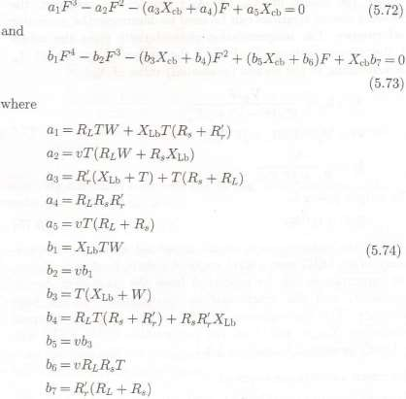


Slide 39
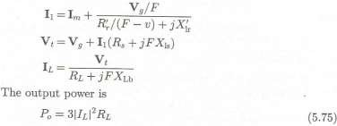
Equations 5.72 and 5.73 can be solved numerically to obtain the values of Xcb and F. The initial value of C should be well above the value required for self-excitation under load and F should be less than the per-unit speed, though close to it.
A mathematical model similar to Eqns (5.72) and (5.73), in terms of the unknown variables Xm and F, can be formulated from Eqn (5.71) for given values of the excitation capacitance, the load, and the speed.
Once the values of Xcb (or Xm) and F are obtained, the following circuit relations can be used to determine the generator performance. The magnetization characteristic gives the values of the air-gap voltage Vg/F and the magnetizing current Im corresponding to the chosen (evaluated) value of Xm:
Using the mathematical model presented above, the performance of an SEIG over a wide range of speeds, load impedances, and capacitances can be predicted from the equivalent circuit parameters and the magnetization characteristic at the base frequency.

Slide 40

4.5.2.2 The nodal admittance method The nodal admittance method has the advantage that it decouples the load and the excitation capacitor branch, and enables the per unit frequency to be determined independent of the value of Xcb.
Figure 5.18 can be redrawn as Fig. 5.19, where

Slide 41
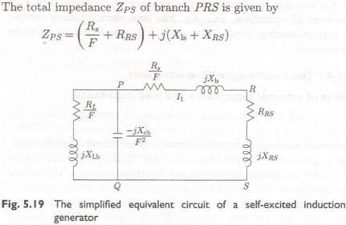
By applying Kirchhoff's current law in Fig. 5.19, the sum of the current at node P equals zero:
where YL, Yc, and Yp are, respectively, the admittances of the series load circuit, the capacitive excitation circuit, and the machine equivalent circuit. Since Vp cannot be zero, for successful voltage build-up, it follows that

Slide 42
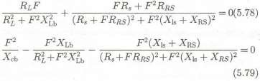
Equating the real and the imaginary parts independently to zero, the following equations are obtained:
Equations (5.78) and (5.79) are alternatives to Eqns (5.72) and (5.73), and are thus amenable to solution in the same manner.
One marked difference can be noted: Eqn (5.78) is independent of Xcb and can be expressed as a 6th degree polynomial in F if the level of saturation, i.e., Xm, has been decided upon earlier. In certain studies, Eqns (5.78) and (5.79) are found to be more convenient.

Slide 43
4.5.3 The Steady-state Characteristics
4.5.3.1 Effect of external capacitance and load impedance
Figure 5.20 shows a typical variation of terminal voltage for resistive lead with the output power at a fixed speed for different values of the excitation capacitance. The curves suggest that, for a given speed and capacitance, an optimal load impedance exists for maximum power output. In these respects, the curves are similar to the output characteristics of a dc shunt generator with different field circuit resistances. The frequency decreases with the lead, but this variation is not significantly affected by the capacitance. Figure 5.21 exhibits the manner in which the capacitance requirement changes with the load and the power factor for constant terminal voltage at a fixed speed. The figure also indicates an increase in the VAR demand with decreasing load power factor.

Slide 44
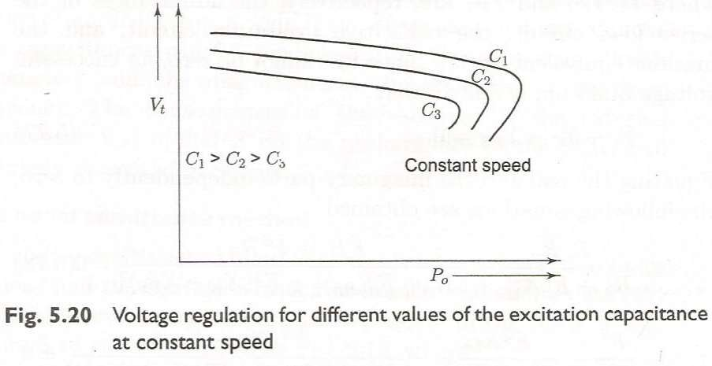
The group of curves shown in Fig. 5.22 shows the effect of controlling the excitation capacitance on the terminal voltage and the output power for a fixed load impedance at a constant speed.
As is clear from these figures, there exist optimal capacitances that maximize the output power and terminal voltage for a given load impedance at a fixed speed.

Slide 45
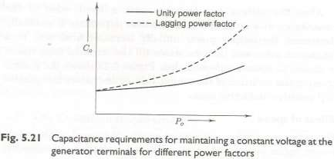
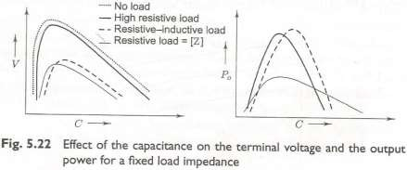

Slide 46
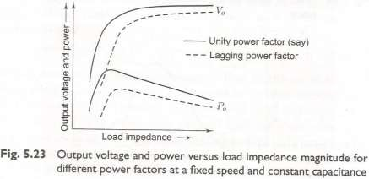
After the voltage has built up with a fixed value of the capacitance at a given speed, as the load impedance is gradually decreased, the output power initially increases from zero to a maximum value and then decreases till the terminal capacitance is unable to sustain self- excitation. Figure 5.23 shows the general trend in the variation of the output voltage and power for resistive and resistive-inductive loads.

Slide 47
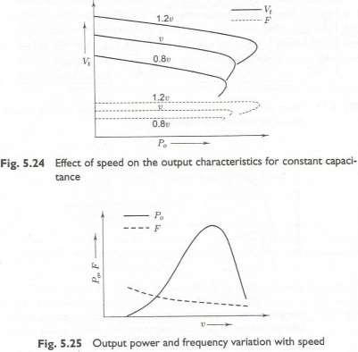
4.5.3.2 Effect of speed
The terminal voltage and output frequency increase almost linearly with speed for the same power output over the working range. Figure 5.25 shows the

Slide 48
4.6 Effect of wind generator on the network Many wind farms are connected to the local network at low, medium, or high voltage. The injection of wind power into the network has an impact on the voltage magnitude, its flicker, and its waveform at the point of common coupling (PCC).
The effect on the voltage magnitude depends on the strength of the utility distribution network at the point of coupling as well as on the active and reactive power of the wind generator(s).
The strength of the system at the point of coupling under consideration is decided by the short-circuit power, called the fault level, at that point. The short-circuit power is the product of the short-circuit current, following a three-phase fault at that point, and the voltage of the system. In fact, a power system comprises many interconnected power sources. The loads are fed through extended transmission and distribution networks. At the point of connection, as illustrated in Fig. 5.28(a), an equivalent ideal voltage source in series with an impedance Z, may be assumed to replace the power system. Thus, the higher the fault current, the lower the source impedance. The wind farm with induction generators receives reactive power from the network and delivers real power to it. Without contribution from the wind generator, the fault level at the point of connection near the wind farm is

Slide 49
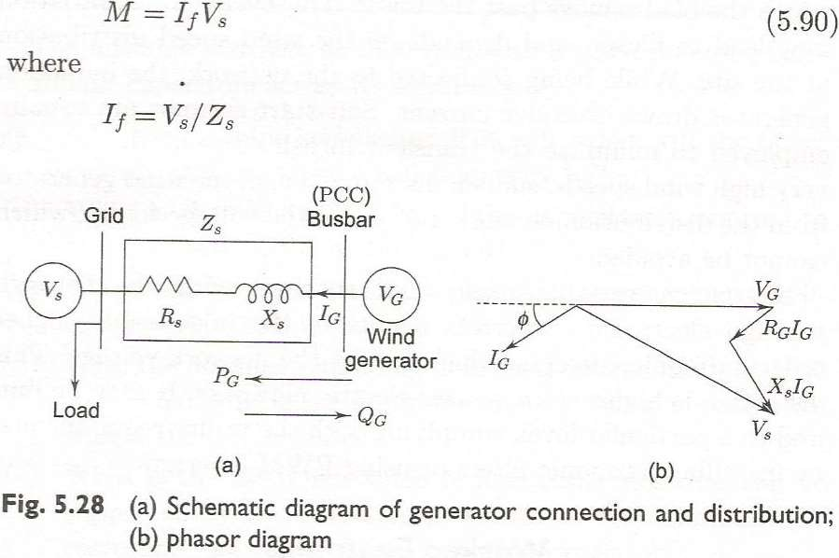

Slide 50

Thus the fault level and hence the network strength are indicative of the source impedance. Areas of high wind velocity are suitable locations for wind farms. These areas are usually sparsely populated. Long transmission and distribution lines are normally required for connecting wind farms with the power system network. As a result, fault level at the wind farms are generally low, making them weak electrical systems.
Thus, at low power delivery, the voltage at the PCC reduces if the induction generator absorbs reactive power from the grid, while, at increased power flow, the voltage rises. Flicker is defined as the unsteadiness of the distribution network voltage. It may be caused by the continuous operation of a wind turbine or the switching operations of turbines. While operating, the rotor of a wind turbine experiences a cyclic torque variation at the frequency with which the blades move past the tower. This cyclic power variation may lead to flicker, and depends on the wind speed distribution at the site. While being connected to the network, the induction generator draws excessive current. Soft-start systems are usually employed to minimize the transient inrush current.

Slide 51
4.7 Wind speed measurements
The device used for wind speed measurement is called an anemometer. There are three different techniques for wind
speed measurement. In general, any measurable
phenomenon that has strong dependence on wind velocity can be used for wind speed measurement. Experience has shown that thrust, pressure, and the cooling effect, are the
three most convenient parameters using which wind speed can be directly measured.

Slide 52
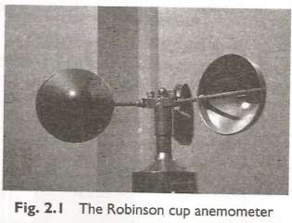
4.7.1 Robinson Cup Anemometer The Robinson cup anemometer consists of a vertical shaft carrying three or four horizontal arms, at the ends of which there are hemispherical cups of thin sheet metal. The circular rims of the cups are in vertical planes passing through the common axis of rotation. The thrust of wind is greater on the concave sides than on the convex ones, thereby leading to the rotation of the vertical shaft (Fig. 2.1).

Slide 53
As this is a vertical-axis device, there is no problem of orientation along the wind direction. The wind velocity has a linear relationship with the speed of rotation, which is measured by a photocell operated digital counter. The display can be precalibrated to give the wind speed directly. Modern devices have facilities for continuous data logging and storage, from which data can be retrieved later for analysis.
At very low wind speeds, the readings of the cup anemometer can be erroneous due to the friction of the bearings. During fast variations of wind speed, the inertia effect may be significant;
e.g., when the wind speed drops quickly, the anemometer tends to rotate faster and takes time to slow down. In spite of these minor drawbacks, the Robinson cup anemometer is the most extensively used instrument for wind speed measurement.

Slide 54
4.7.2 Pressure Tube Anemometer
The pressure tube anemometer a simple mechanical device suitable for stand-alone application in remote windy locations. Structure-wise, it has two distinct parts. The head, which is usually mounted on a mast at the desired height, consists of a horizontal tube, bent at one end and supported by two concentric vertical tubes. The horizontal end is connected to the inner tube.
At the other side of the outer tube, there are a few holes a little below the horizontal tube. The entire head is free to rotate, which is turned to face the wind by a vane.

Slide 55
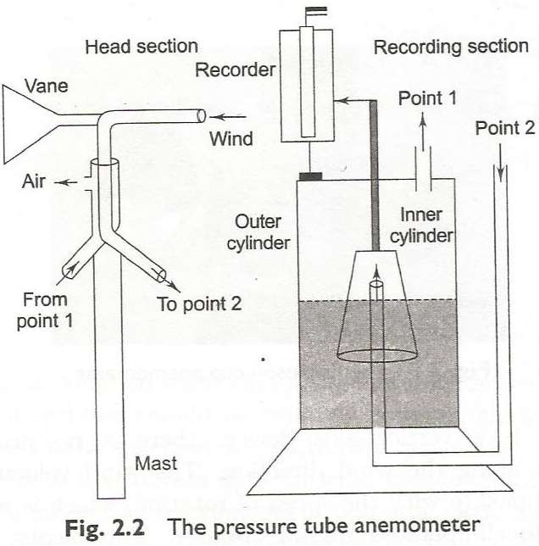
The wind blowing into the horizontal tube creates pressure, which is communicated through a flexible tube to a recorder.

Slide 56
4.7.3 Hot Wire Anemometer A hot wire anemometer uses the cooling effect of wind on an electrically heated platinum or tungsten wire to measure wind velocities. The wire is heated by a constant-current source. With the variation of wind speed, the wire temperature varies, which varies the resistance of the wire. Naturally, in order to find the wind speed, it suffices to measure the resistance of the wire using any standard method. The calibration has to take into account the resistance- temperature characteristics of the wire and the ambient temperature of air.
In a hot wire anemometer, the temperature difference between the wire and the ambient air is inversely proportional to the square root of the wind velocity:
Because of this relation, this anemometer is useful especially for measuring small wind velocities.

Slide 57


4.8 Wind speed statistics
Since the power contained in wind varies with the cube of the wind speed, the average wind speed available at a particular site is the first criterion to be considered in site selection. During the site identification process, the measuring instruments described in the previous section are installed at the site.
The annual average wind speed is calculated according to the equation
where 𝑣 is the annual average wind speed (m/s), v is the instantaneous wind speed (m/s), and t2 – t1 is the duration of one year (8760 hrs).
In the case of a digital data logger recording wind speed data at regular intervals, the average wind speed can be calculated as

Slide 58

where vi is the wind speed at the ith observation and n is the number of observations.
At any given site, the wind speed varies with the height from the ground
level. It is generally not possible to install measuring instruments at all heights, but an empirical formula can be used to find the mean wind speed at a certain height using the observed mean wind speed at 10 m:
where 𝑣_{𝐻} is the annual average wind speed at height H (m/s), 𝑣₁₀ is the annual average wind speed at 10 m (m/s), and x is an exponent that depends on the roughness of the ground. The values of x are given in Table 2.1.

Slide 59
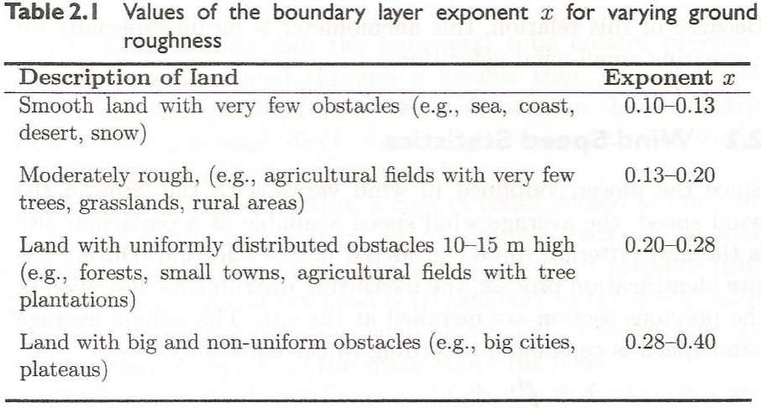

Slide 60
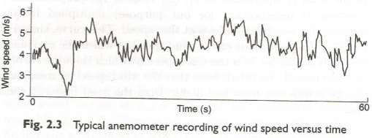
The measuring instruments record the wind speed continuously against time. If the data are collected throughout a year, the resulting chart would look like a long wavy line, as shown in Fig. 2.3.
It is clear that this plot is too wavy and irregular for us to obtain any useful information from it. The next step is to obtain, from Fig. 2.3, the plot of wind speed v versus the total time during a year for which the wind speed is v (Fig. 2.4), called the wind speed distribution curve. Of course, the period of time for which the wind speed assumes an exact value is infinitely small. So, the vertical axis actually gives the annual duration for which the wind speed falls within certain limits, for instance 0.5 m/s below and above v.

Slide 61
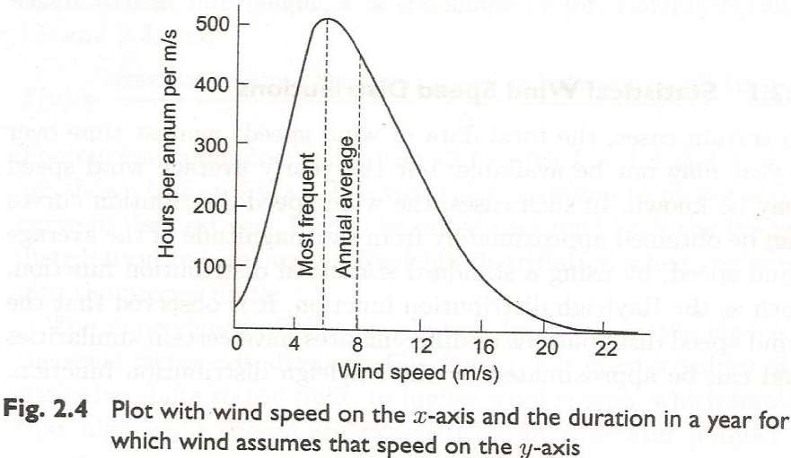

Slide 62
It is easy to plot the energy distribution curve for a site the energy available at a particular wind speed is the power contained in the wind (proportional to v, the value of the proportionality constant is unimportant for our purpose) multiplied by the duration for which wind blows at that speed. This curve, shown in Fig. 2.5, gives the value of the wind speed at which the maximum energy is available it is the wind speed at which the wind turbine should normally be rated. Note that the wind speed for maximum energy is different from and higher than the most frequent wind speed.

Slide 63
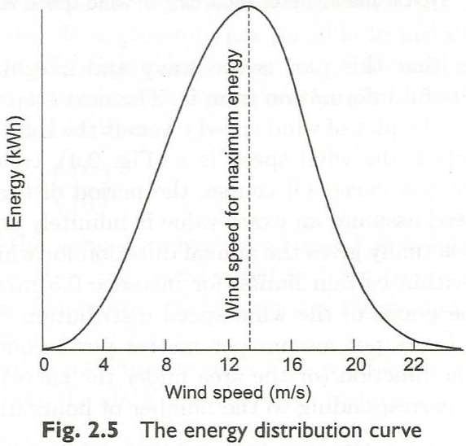

Slide 64
4.9 Site and turbine selection.
Site selection involves not only the choice of the geographical location for a wind turbine or a wind farm, but also the model of the turbine that is best suited to a particular site.
For the final selection process, that is, while choosing the wind turbine that is best suited for a particular site, a modification of the curve shown in Fig. 2.4 is necessary. At this stage, we plot the speed-duration curve the graph of v versus the total duration for which the wind speed
exceeds or equals v (Fig. 2.7). Naturally, the largest coordinate on the y-axis is the number of hours in a year (8760), when the wind speed exceeds zero. If the wind speed is measured using a digital recorder with data logging facility, the wind speed distribution and duration curves can be obtained directly or generated by a computer later using the stored data.

Slide 65
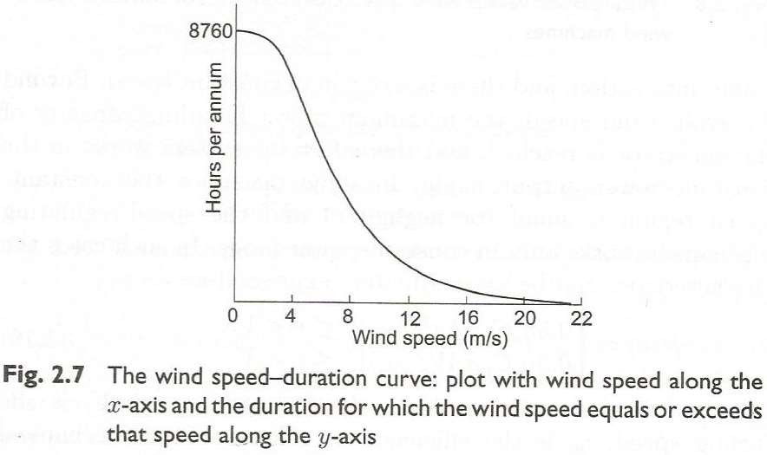

Slide 66
The productivity of any wind generator at a particular site depends on the characteristics of the site (given by Fig. 2.7) and those of the wind machine. The latter are given as the power versus wind speed characteristics (such as that shown in Fig. 2.8), which are generally available for all commercially produced wind machines.
Every wind turbine model has a specific cut-in speed, a rated speed, a furling speed, and power versus wind speed characteristics within the wind speed range between the cut-in speed and the furling speed. At the cut-in speed the wind generator starts generating power. As the wind speed increases, the
power output increases in proportion with the power contained in the wind. After the rated speed is reached, the speed-regulating mechanism comes into action, and there is a region of constant speed.

Slide 67
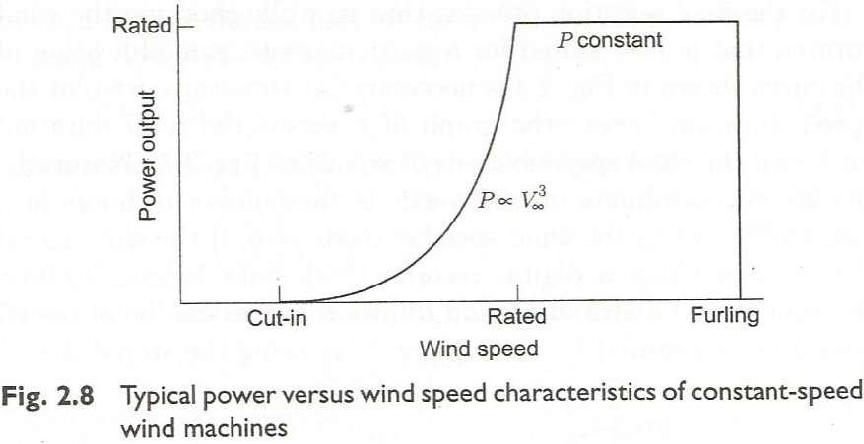
Beyond a certain wind speed, the maximum power handling capacity of the generator is reached, and thereafter the system works in the constant-power output mode. In some machines the constant speed region is small (or negligible) and the speed-regulating

Slide 68

mechanism works only in constant-power mode. In such cases the characteristics can be approximately expressed as
where Vc is the cut-in speed, Vr is the rated speed, Vf is the furling speed, η_{𝑣} is the efficiency of generator and mechanical transmission, Cp is the wind turbine coefficient of performance, ρ is the density of air, A is the blade swept area, and v is the wind speed. At the furling wind speed, the plant is shut down to avoid damage.
From Fig 2.8 and 2.7, the wind generator's characteristics, as weighted by the site's wind speed-duration curve, yield the power-duration characteristics. For each value of wind speed shown in Fig. 2.7, the corresponding value of the output power is obtained from Fig. 2.8. The typical output power-duration curve for a wind turbine is shown in Fig. 2.9. To illustrate, we have also shown the wind power-duration curve (obtained by the relation 0.5η_{𝑣}CpρAv³), so that the energy loss due to cut-in and furling becomes clear.

Slide 69
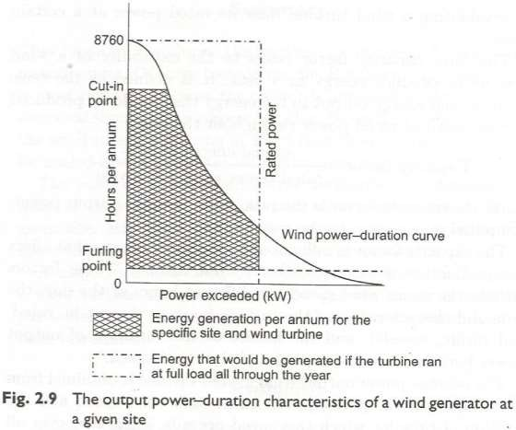

Slide 70
The area under the output power-duration curve measures the energy output of a particular machine at a given site. By plotting similar curves for different machines is at a particular site, one can choose the appropriate machine. One generally chooses the model that gives the maximum output for a specific rated power at a particular site.

